Slide 1


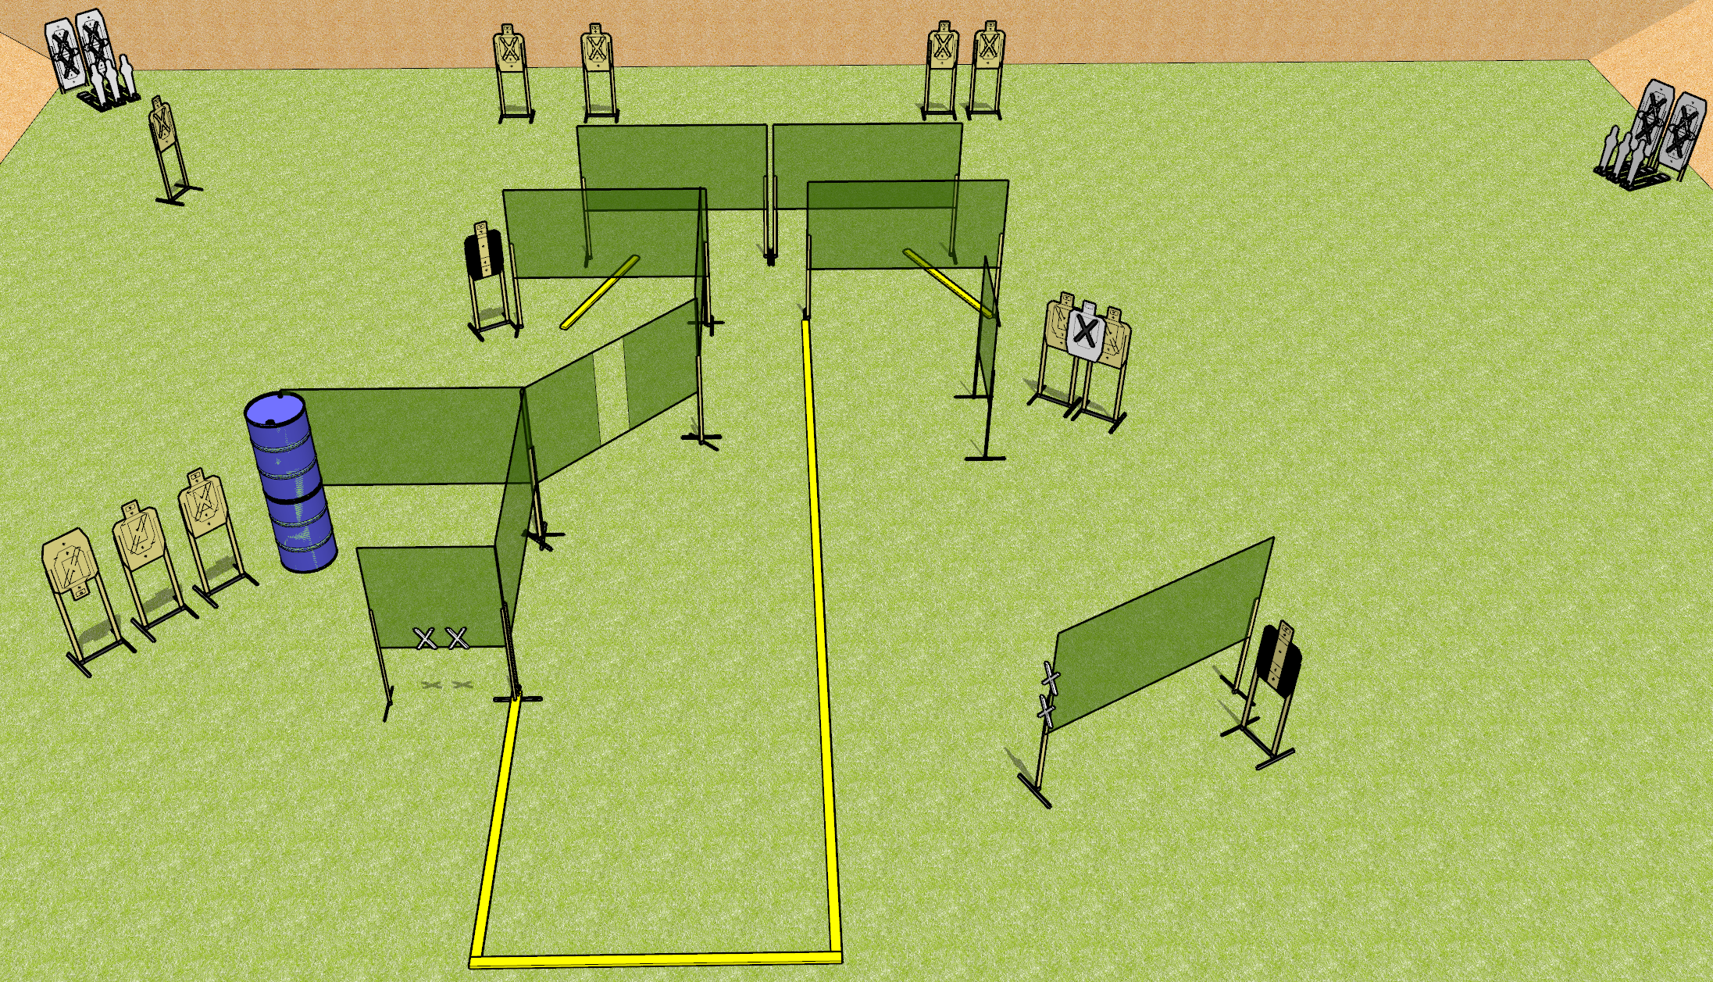
 | Dothan Gun Club – USPSA Match Drew’s an Asshole Course Designer : Drew Coleman
START POSITION : completely outside the shooting area not touching fault lines, both hands touching marks. PCC muzzle touching any mark.
GUN READY CONDITION : Pistol loaded and holstered. PCC loaded, shouldered, held with both hands, safety on, muzzle touching a mark. |  | SCORING: Comstock, 30 rounds TARGETS: 12 paper, 6 Steel SCORED HITS: Best 2 on paper, steel until down START-STOP: Audible, last shot RULES:
STAGE PROCEDURE: Engage targets as they become available from within the fault lines.

Slide 2
Drew’s an Asshole
Written Stage Briefing
Drew’s an Asshole is a 30 round, 150 point, Comstock field course. There are twelve USPSA targets and six mini poppers. The best two hits on paper will score, and steel must fall to score. The start signal is audible.
Handgun start position is standing completely outside the shooting area, not touching any fault lines, hands touching either set of marks. Handgun is loaded and holstered
PCC start position is standing completely outside the shooting area, not touching any fault lines, muzzle touching any mark. Loaded carbine is held with both hands, safety on, shouldered.
Upon start signal, engage targets as they become available from within the shooting area. You may curse Drew and his no-shoots after the range has been called clear.

